Slide 1




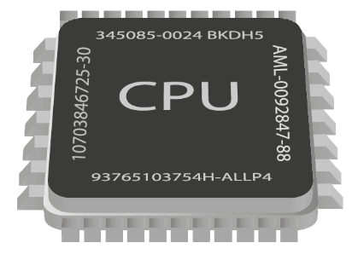
Asynchronous Programming
Writing Asynchronous Code in Java
Java
Advanced
SoftUni Team
Technical Trainers
Software University
http://softuni.bg

Slide 2

Table of Contents
Processes, Threads, Tasks
Sync and Async Programming
Java High Level Threading
Race Conditions
Atomicity
Volatile

Slide 3
Questions
sli.do #JavaFundamentals

Slide 4


Single and Multi Threading
Executing Tasks Sequentially or Concurrently
Notes:
Executing program components sequentially
i.e. "Sequential programming"
Actions happen one after another
Uses a single thread of a single process
Components wait for previous components to finish
Program resources are accessible at all points

Slide 5
Time Slicing
A computer can run many processes (applications) at once
But single core CPU can execute one instruction at a time
Parellelism is achieved by the operating system's scheduler
Grants each process a small interval of time to run
system.exe
chrome.exe
skype.exe
system.exe
…
0 ms
10 ms
Processes
Notes:
What is Multi-Tasking?
How do single core single CPU computers achieve Multi-Tasking?
What is a process?
What is a thread?
How threads wait in priority queues for processor resources (time, memory)?

Slide 6
Multi-Threading
Processes have threads (at least a main thread)
Similar to OS Multi-Tasking
By switching between threads, a process can do multiple tasks "at the same time"
Thread 1
Thread 2
Thread 1
Thread 2
…
0 ms
10 ms
Threads
Notes:
What is Multi-Tasking?
How do single core single CPU computers achieve Multi-Tasking?
What is a process?
What is a thread?
How threads wait in priority queues for processor resources (time, memory)?

Slide 7

Threads
A thread executes a task
A thread can start other threads
Main Thread
Thread 1
Thread 2
Multiple Threads "At the same time"
Thread 3

Slide 8
Tasks
A task is a block of code that is executed by a Thread
A Task in Java is represented by the Runnable class
Runnable task = () -> {
for (int i = 0; i < 10; i++) {
System.out.printf("[%s] ", i);
}
};

Slide 9
Threads in Java
A single thread is represented by the Thread class
Runnable task = () -> {
for (int i = 0; i < 10; i++) {
System.out.printf("[%s] ", i);
}
};
Thread thread = new Thread(task);
thread.start();
Starts the given task

Slide 10
Joining Threads
Join == waiting for a thread to finish
Thread thread = new Thread(() -> {
while (true) { }
});
thread.start();
System.out.println("Executes.");
thread.join();
System.out.println("Can't be reached.");
Blocks the calling thread

Slide 11
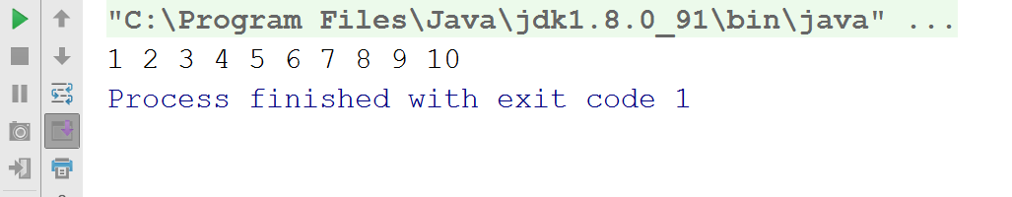
Problem: Single Thread
Create a task that prints the numbers from 1 to 10
Start a thread executing the task
Add System.exit(1) at the end of your program
Experiment with thread.join()
Exits the program

Slide 12
Solution: Single Thread
Thread thread = new Thread(() -> {
for (int i = 1; i <= 10; i++) {
System.out.print(i + " ");
}
});
thread.start();
thread.join();
System.exit(1);
Try to remove this line

Slide 13
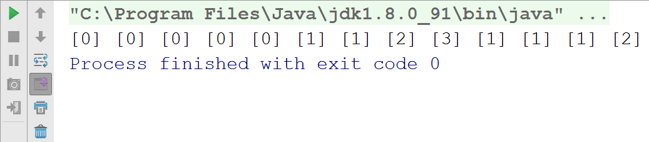
Problem: Multi-Thread
Create a task that prints the numbers from 1 to 10
Start 5 threads executing the same task
After each printing, add Thread.yield() statement
Join all threads
Signals CPU that another thread can be processed

Slide 14
Solution: Multi-Thread
Runnable task = () -> {
for (int i = 0; i < 10; i++) {
System.out.printf("[%s] ", i);
Thread.yield();
}
};
// continues…
Try to comment this line

Slide 15
Solution: Multi-Thread (2)
// Create the task
Thread[] threads = new Thread[5];
for (int i = 0; i < 5; i++)
threads[i] = new Thread(task);
threads[i].start();
for (Thread thread : threads)
thread.join();

Slide 16
Thread Interruption
interrupt() – notifies the thread to interrupt its execution
Thread thread = new Thread(task);
thread.start();
thread.interrupt();
Runnable task = () -> {
if (Thread.currentThread().isInterrupted())
// Safely break the task
}

Slide 17
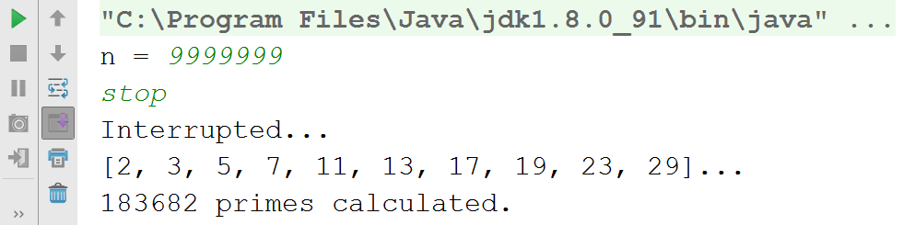
Problem: Responsive UI
Create a program that prints the primes from 0 to N
Implement a responsive UI, e.g. user can stop the program
If stopped, show appropriate message

Slide 18
Solution: Responsive UI
// Create task and thread
while (true) {
String command = scanner.nextLine();
if (command.equals("stop")) {
thread.interrupt();
break;
} else
System.out.println("unknown command");
}
thread.join();

Slide 19
Solution: Responsive UI (2)
// Task
List<Integer> primes = new ArrayList<>();
for (int number = 0; number < to; number++)
if (isPrime(number))
primes.add(number);
if (Thread.currentThread().isInterrupted()) {
System.out.println("Interrupted...");
break;
}
}

Slide 20
Multi-Threaded Code
Two main benefits:
Responsive User Interface (UI)
Better CPU Utilization

Slide 21
Multi-Threaded CPU Utilization
Heavy Operation
Single-Threaded
Multi-Threaded
Task 1
Task 2
Task 3
…
Percieved time is less
Task 1
Task 3
…
Task 2

Slide 22
High Level Threading
ExecutorService class provides easier thread management
Several thread pool types are available
ExecutorService es =
Executors.newFixedThreadPool(2);
Runnable task = () -> isPrime(number);
es.submit(task);

Slide 23
Executor Service
ExecutorService es = Executors.newFixedThreadPool(2);
Task 1
Process
Task 2
Task 3
Task 1
Task 3
Task 4
Task 2
Task 4
Task 5
Task 5

Slide 24
Returning Value from a Task
Future<T> - defines a result from a Callable:
ExecutorService es = Executors.newFixedThreadPool(4);
Future<Boolean> future = es.submit(() -> isPrime(number));
if (future.isDone())
System.out.println(future.get());
blocks until done

Slide 25
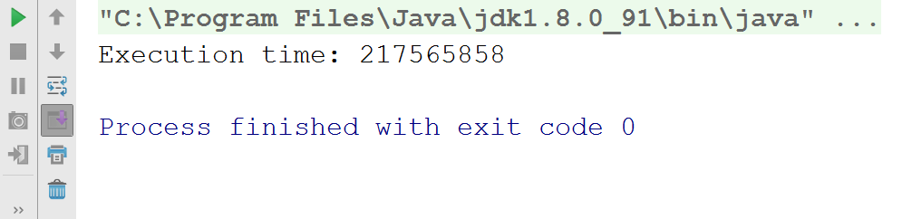
Problem: Benchmarking
Test every number in the range [0...N] if it is prime or not
Spread the calculation over 2 or 4 threads
Benchmark and compare the difference over one thread
Benchmark both efficient and inefficient isPrime()

Slide 26
Solution: Benchmarking
Create a List<Integer> for all numbers in range [0..N]
Start timer (System.nanoTime())
Submit a task for each number, returning a Future<Boolean>
Await termination and shutdown ES
Stop timer (System.nanoTime())

Slide 27

Single and Multi-Threading
Exercises in Class

Slide 28

Resource Sharing
Tasks Interfering with Each Other
Notes:
Executing program components sequentially
i.e. "Sequential programming"
Actions happen one after another
Uses a single thread of a single process
Components wait for previous components to finish
Program resources are accessible at all points

Slide 29

Atomicity
Atomic action is one that happens all at once
Java – reads and writes on primitives (except double and long)
int a = 5; // atomic
int b = 6;
a++; // non-atomic
a = a + b;
a = b;

Slide 30
Race Conditions
Two different threads try to read and write data at the same time
Thread A
17
+1
Thread B
17
+1
Bank Acc
18
18
17
read
read
write
write
Initial balance
Should be 19!

Slide 31
Problem: Transactions
Create a simple class BankAccount:
Property: int balance
Method: void deposit(int sum)
Create a multi-threaded program that simulates 100 transactions, each deposing 100 times 1 to the balance

Slide 32
Solution: Transactions (Unsafe)
class Account {
int balance;
void deposit(int amount) {
balance = balance + amount;
}
}
Unsafe: Read + Write Operation

Slide 33
Solution: Transactions (Unsafe) (2)
Runnable task = () -> {
for (int i = 0; i < 100; i++) {
account.deposit(1); }
};
Unsafe: This may produce incorrect result
Thread[] threads = new Thread[transactions];
for (int i = 0; i < 100; i++)
threads[i] = new Thread(task);
threads[i].start();

Slide 34
Synchronized Keyword
synchronized
Grants access to only one thread at a time
Blocks other threads until the resource is released
In other words, makes an operation atomic
synchronized (Object) {
// Thread safe code
}

Slide 35
Problem: Thread Safe Transactions
Modify previous problem to get same correct result every time
100 transactions, each deposing 100 times 1 to the balance

Slide 36
Solution: Transactions
class Account {
int balance;
synchronized void add (int amount) {
balance = balance + amount;
}
}
synchronized method

Slide 37
Solution: Transactions (2)
class Account {
int balance;
void deposit (int amount) {
synchronized (this) {
balance = balance + amount;
}
}
}
synchronized block

Slide 38

Synchronized - Locks
Synchronized works by taking an object's Key
Thread A
17
+1
Thread B
18
+1
Bank Acc
18
19
17
read
read
write
read
write
Result is correct!

Slide 39
Locks – The Key
Every java object can be a key
For static methods – Key is the class itself
class Account {
int balance;
synchronized void add (int amount) {
balance = balance + amount;
}
}
The object is the key
Account johnsAccount = new Account();

Slide 40


Deadlocks
THREAD 1
THREAD 2
Instance of Class A
Instance of Class A
Deadlock Scenario
Method A
Method A
Method B
Method B
Method C
Method C

Slide 41
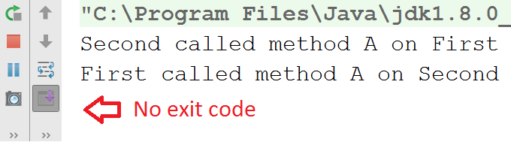
Problem: Deadlock
Reproduce the deadlock scenario from the previous slide
Use Thread.sleep()
THREAD 1
THREAD 2
To make sure methods execute at the same time
Instance of Class A
Instance of Class A
Method A
Method A
Method B
Method B
Method C
Method C

Slide 42
Solution: Deadlock
static class MyClass {
String id;
public MyClass(String id) {}
synchronized void a(MyClass other) {}
synchronized void b(MyClass other) {}
synchronized private void c() {}
}

Slide 43
Solution: Deadlock (2)
MyClass first = new MyClass("First");
MyClass second = new MyClass("Second");
Thread tFirst = new Thread(() -> first.a(second));
Thread tSecond = new Thread(() -> second.a(first));
tFirst.start();
tSecond.start();

Slide 44
Visibility
Main Memory
a = 1
Incorrect Read
L1 Cash
L1 Cash
a = 2
a = 1
a = 1
Core 1
Core 2
a++

Slide 45

Visibility (2)
Every write inside a synchronized block is guaranteed to be visible
Use volatile keyword
Every write is flushed to main memory
class Account {
volatile int balance;
synchronized void add (int amount) {
balance = balance + amount;
}
}

Slide 46

Concurrent Classes
Java java.util.concurrent package provides thread-safe collection classes
Some notable concurrent collections:
ConcurrentLinkedQueue
ConcurrentLinkedDeque
ConcurrentHashMap

Slide 47

Race Conditions
Exercises in Class

Slide 48
Summary
A thread is a unit of code execution
Multithreading means a program can do several operations in parallel by using many threads
Used to offload CPU-demanding work so the main thread does not block
Can lead to synchronization issues and unexpected results
Java has many useful tools for asynchronous programming
synchronized and volatile keywords
java.util.concurrent

Slide 49







Stream API
https://softuni.bg/courses/

Slide 50





Trainings @ Software University (SoftUni)
Software University – High-Quality Education, Profession and Job for Software Developers
softuni.bg
Software University Foundation
http://softuni.foundation/
Software University @ Facebook
facebook.com/SoftwareUniversity
Software University Forums
forum.softuni.bg

